Slide 1


Chapter 5
Organizing and Writing Business Messages

Slide 2
Topics in This Chapter
Research Methods
Ways to Organize and Group Ideas
The Direct and Indirect Patterns
How to Create Effective Sentences
How to Create Effective Paragraphs

Slide 3

Types of Formal Research Methods
Accessing information electronically on the Internet and in databases
Searching manually in books, articles, and other secondary sources
Investigating primary sources, such as interviews and surveys
Experimenting scientifically with control groups

Slide 4

Types of Informal Research Methods and Idea Generation
Looking in the company files
Talking with your boss
Interviewing the target audience
Conducting an informal survey
Brainstorming for ideas
Developing a cluster diagram

Slide 5
Use Cluster Diagrams to Generate, Organize, and Classify Ideas
Paid gym membership
Smoking- cessation programs
Gifts and premiums
New menu in cafeteria
Financial incentives
Improving employee health
Flex time for workouts
Seminars and workshops
Peer mentors
Guest speakers

Slide 6
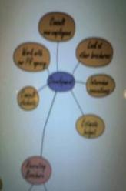
Tips for Organizing Ideas in a Cluster Diagram
Analyze the ideas generated in the original cluster diagram.
Cross out ideas that are obviously irrelevant; simplify and clarify.
Add new ideas that seem appropriate.
Study the ideas for similarities.

Slide 7
Tips for Organizing Ideas in a Cluster Diagram
Group similar ideas into classifications.
Prepare an outline if the organization seems clear.
Make subcluster circles around each classification for further visualization.

Slide 8
Methods for Organizing Ideas
Listing
Outlining

Slide 9
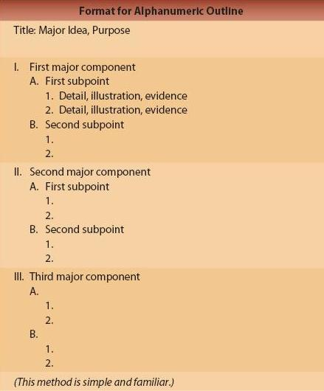
The Alphanumeric Outline

Slide 10
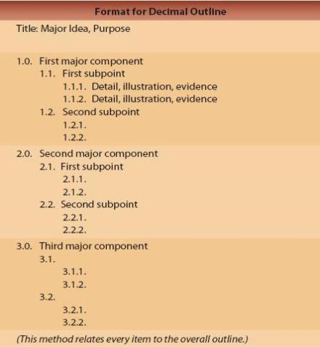
The Decimal Outline

Slide 11
Tips for Making Outlines
Define the main topic (purpose of message) in the title.
Divide the main topic into major components or classifications (preferably three to five); if necessary, combine small components into one larger category.
Break each major component into subpoints.

Slide 12
Tips for Making Outlines
Avoid putting a single item under a major component; if you have only one subpoint, integrate it with the main item above it or reorganize.
Try to make each component exclusive (no overlapping).
Use details, illustrations, and evidence to support subpoints.

Slide 13
Methods for Grouping Ideas Into Patterns
The direct pattern for receptive audiences
The indirect pattern for unreceptive audiences

Slide 14
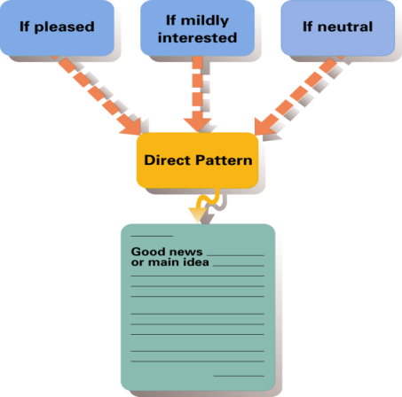
For Receptive Audiences, Use the Direct Pattern to Group Ideas

Slide 15
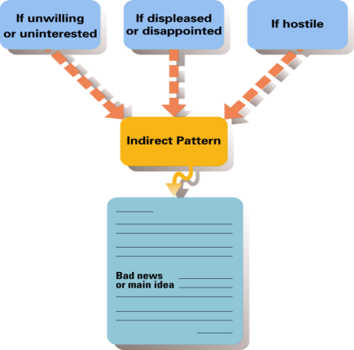
For Unreceptive Audiences, Use the Indirect Pattern to Group Ideas

Slide 16

Creating Effective Sentences
Recognize phrases and clauses.
Clauses have subjects and verbs; phrases do not.
Independent clauses are complete; dependent clauses are not.
Phrases and dependent clauses cannot function as sentences.
Notes:
8

Slide 17
Creating Effective Sentences
Recognize phrases and clauses.
Independent clause: They were eating pizza
Dependent clause: that they want
Phrase: to return for a refund
Notes:
8

Slide 18

Creating Effective Sentences
Avoid fragments (incomplete sentences).
Fragment: E-mail seems boring. When compared with Twitter.
Revision: E-mail seems boring when compared with Twitter.

Slide 19
Creating Effective Sentences
Avoid run-ons (a sentence with two independent clauses – without a coordinating conjunction or a semicolon).
Run-on: He posts updates hourly he’s always connected.
Revision: He posts updates hourly; he’s always connected.
Revision: He posts updates hourly. He’s always connected.

Slide 20
Creating Effective Sentences
Avoid comma splices (joining two independent clauses without using a coordinating conjunction).
Splice: Her BlackBerry is part of her, she can’t live without it.
Revision: Her BlackBerry is part of her; she can’t live without it.
Revision: Her BlackBerry is part of her. She can’t live without it.

Slide 21

Creating Effective Sentences
Use short sentences.
Sentence Length | Comprehension Rate
8 words | 100%
15 words | 90%
19 words | 80%
28 words | 50%
Sentences under 20 words are most readable.
Notes:
8

Slide 22
Creating Effective Sentences
Emphasize the most important ideas by using vivid words.
General | Vivid
One business uses personal selling techniques. | Avon uses face-to-face selling techniques.
The skyscraper is very tall. | The Empire State Building is 102 stories tall.
Notes:
8

Slide 23
Creating Effective Sentences
Emphasize the main idea by labeling it.
Unlabeled | Labeled
Explore the possibility of leasing a site, but also hire a consultant. | Explore the possibility of leasing a site; but, most important, hire a consultant.
Include a copy of the sales receipt with the defective item you’re returning. | It’s essential you include a copy of the sales receipt with the defective item you’re returning.
Notes:
8

Slide 24
Creating Effective Sentences
Emphasize the most important idea by placing it first or last in a sentence.
Unemphatic | Emphatic
All production and administrative personnel will meet on May 23, at which time we will announce a new plan of salary incentives. | On May 23 all personnel will meet to learn about salary incentives.
Notes:
8

Slide 25
Creating Effective Sentences
Emphasize the most important idea by placing it in a simple sentence or in an independent clause.
Unemphatic | Emphatic
Although you are the first trainee that we have hired for this program, we have interviewed many candidates and expect to expand the program in the future. | You are the first trainee that we have hired for this program.
Notes:
8

Slide 26
Creating Effective Sentences
Emphasize the most important idea by making sure it is the subject of the sentence.
Unemphatic | Emphatic
The report was written by Courtney. (De-emphasizes Courtney; emphasizes the report) | Courtney wrote the report. (Emphasizes Courtney)
Notes:
8

Slide 27
Creating Effective Sentences
Use active-voice verbs for most sentences.
Example of an active-voice expression: We lost money.
Use passive-voice verbs to de-emphasize the performer or to be tactful.
Example of a passive-voice expression: Money was lost (by us).
Notes:
8

Slide 28
Use Active Voice for Directness, Vigor, and Clarity
Direct and Clear in Active Voice | Indirect and Less Clear in Passive Voice
The manager completed performance reviews for all employees. | Performance reviews were completed for all employees by the manager.
Evelyn initiated a customer service blog last year. | A customer service blog was initiated last year.
IBM will accept applications after January 1. | Applications will be accepted after January 1 by IBM.
Notes:
8

Slide 29
Use Passive Voice to Be Tactful or to Emphasize the Action Rather Than the Doer
Less Tactful or Effective in Active Voice | More Tactful or Effective in Passive Voice
We cannot grant you credit. | Credit cannot be granted.
The CEO made a huge error in projecting profits. | A huge error was made in projecting profits.
I launched a successful fitness program for our company last year. | A successful fitness program was launched for our company last year.
Notes:
8

Slide 30
Creating Effective Sentences
Avoid misplaced modifiers by keeping phrases close to the words they describe.
Not This | But This
An autopsy revealed the cause of death to be strangulation by the coroner. | An autopsy by the coroner revealed the cause of death to be strangulation.
Sam bought a used computer from the salesperson with a faulty mouse. | Sam bought a used computer with a faulty mouse from the salesperson.
Notes:
8

Slide 31
Creating Effective Sentences
Avoid dangling modifiers (a word or phrase that modifies a word not clearly stated in the sentence).
Not This | But This
Walking down the street, our sign is easy to see. | Walking down the street, people can easily see our sign.
When six years old, my family moved to Pittsburgh. | When I was six years old, my family moved to Pittsburgh.
Notes:
8

Slide 32
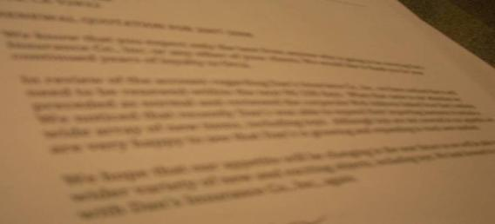
Drafting Effective Paragraphs
¶
To create effective paragraphs, discuss only one topic in a paragraph.
Group similar ideas together.

Slide 33
Drafting Effective Paragraphs
¶
Arrange paragraphs in one of these plans.
Direct Plan
Main sentence followed by supporting sentences (best for defining, classifying, illustrating, and describing ideas)
Pivoting Plan
Limiting sentences, main sentence, supporting sentences (for comparing and contrasting)
Indirect Plan
Supporting sentences, main sentence (good for describing causes followed by effects)

Slide 34
Drafting Effective Paragraphs
¶
To build coherence, link ideas with one of these devices.
Sustain the key idea
Repeat a key expression or use a similar one throughout a paragraph.
Dovetail sentences
Connect the beginning of each new sentence with a word from the end of the previous sentence.
Use a pronoun
Use a pronoun in one sentence to refer to a noun in the previous sentence.

Slide 35

Techniques for Building Coherence
Sustain the key idea by repeating or rephrasing it.
For example, Our philosophy holds that every customer is really a guest. All new employees to our theme parks learn to treat guests as VIPs. Employees never tell these VIPs what they can or cannot do.

Slide 36

Techniques for Building Coherence
Dovetail sentences by connecting the beginning of each new sentence with a word from the end of the previous sentence.
For example, New hosts and hostesses learn about the theme park and its facilities. These facilities include telephones, food services, bathrooms, and attractions.

Slide 37

Techniques for Building Coherence
Use a pronoun in one sentence to link to its antecedent.
For example, All new park employees receive a two-week orientation. They learn that every staffer has a vital role in preparing for the show.

Slide 38
Techniques for Building Coherence
To further build coherence, use transitional expressions.
To Add or Strengthen | To Show Cause and Effect | To Suggest Contrast
additionally | consequently | by contrast
again | as a result | conversely
also | for this reason | on the contrary
likewise | therefore | on the other hand

Slide 39
Techniques for Building Coherence
To further build coherence, use transitional expressions.
To Show Time or Order | To Clarify | To Contradict
after | for example | actually
before | in other words | however
earlier | for instance | instead
finally | I mean | rather

Slide 40

Drafting Effective Paragraphs
Compose short paragraphs.
Paragraphs with eight or fewer printed lines are most readable – and will reduce the chances your audience will fall asleep!
By John S. Donnellan

Slide 41
End

